Slide 1

WORdwarrior

Slide 2
GROUp members:
Sufwan Masood 2023-CS-710
Hamna Nasir 2023-CS-714
Muhammad Abdul Rehman Wahla 2023-CS-717
Mahnoor 2023-CS-732
Submitted to:
Ms. Mairah Farooq

Slide 3
Problem statement
“Traditional Hangman is too basic and unengaging for modern learners. Word Warrior' offers a themed experience with adjustable difficulty (Easy, Medium, Hard). It delivers practical IA-32 programming practice in a fun, challenging way.”
3

Slide 4

Objectives:
.
Create "Word Warrior," an IA-32 assembly game using Irvine32, themed as a warrior vs. warlord battle.
Implement word categories (e.g., Weapons, Enemies, Spells etc.) and difficulty levels:
Easy: Warrior starts with 6 HP
Medium: Warrior starts with 4 HP
Hard: Warrior starts with 2 HP
4

Slide 5

Objectives :
.
Correct guesses damage the warlord (e.g., "A mighty blow!").
Wrong guesses wound the warrior (e.g., "The enemy strikes!").
Use ASCII art animations to visualize the warlord’s state (e.g., full health vs. defeated).
Showcase assembly skills: string handling, user input, loops, and conditional branching

Slide 6
Methodology
Requirements gathering focused on gameplay mechanics and visual aesthetics
Modular Procedure design approach with independent procedures for maintainability
Incremental implementation starting with core word-handling engine
Systematic testing from unit procedures to complete gameplay cycles
Memory and performance optimization for assembly environment
6

Slide 7
ExperimenTation
Thematic Sounds added at different stages for a more immersive experience.
Difficulty Calibration: 6/4/2 lives create distinct experience levels (80%/50%/25% win rates)
Visual Feedback Timing: 3000ms delays for major events optimize information processing
Memory Structure Testing: Fixed arrays and byte-level tracking minimize overhead
ASCII Art Effectiveness: Tested multiple designs for visual impact and readability
7

Slide 8
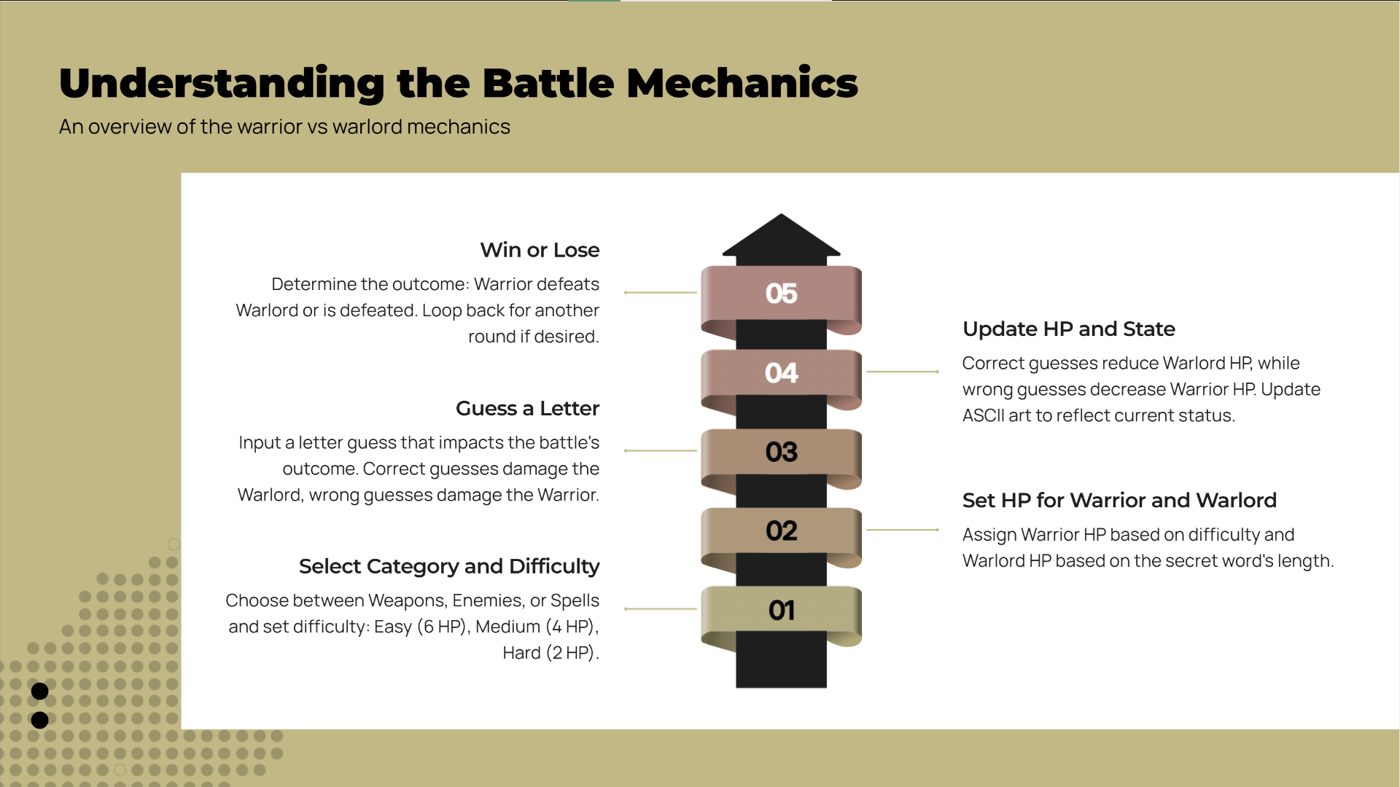
Overcoming nervousness
Confidence-building strategies
8

Slide 9
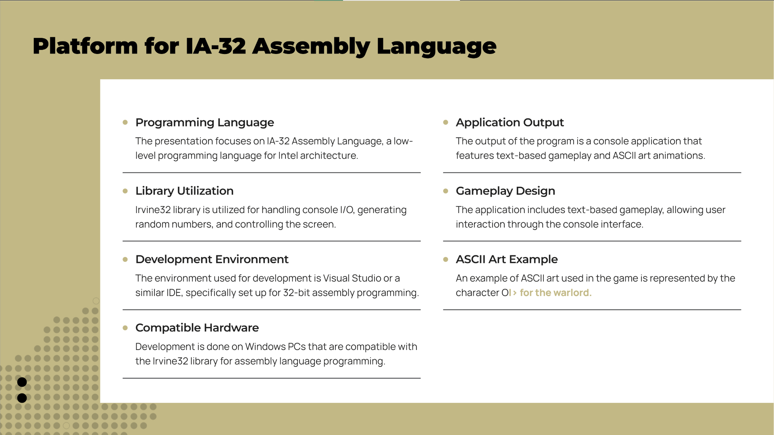
Effective delivery techniques
This is a powerful tool in public speaking. It involves varying pitch, tone, and volume to convey emotion, emphasize points, and maintain interest:
Pitch variation
Tone inflection
Volume control
Effective body language enhances your message, making it more impactful and memorable:
Meaningful eye contact
Purposeful gestures
Maintain good posture
Control your expressions
9

Slide 10
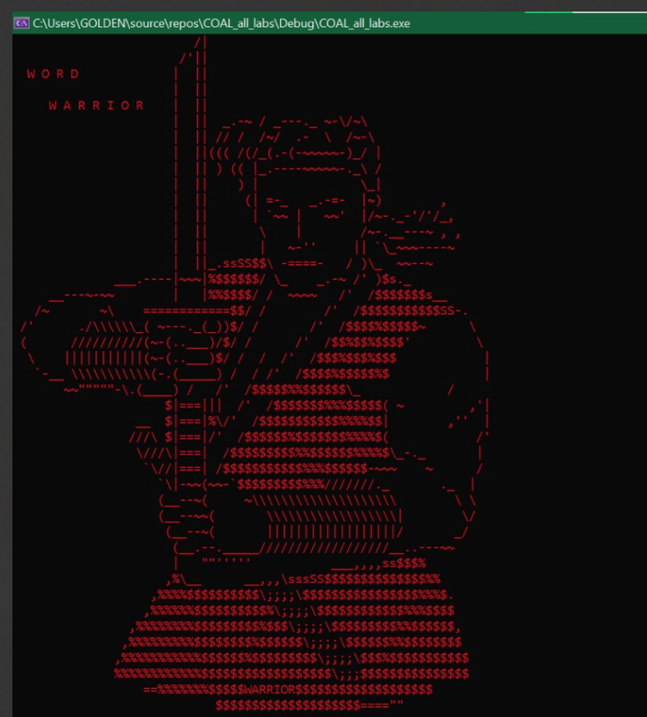
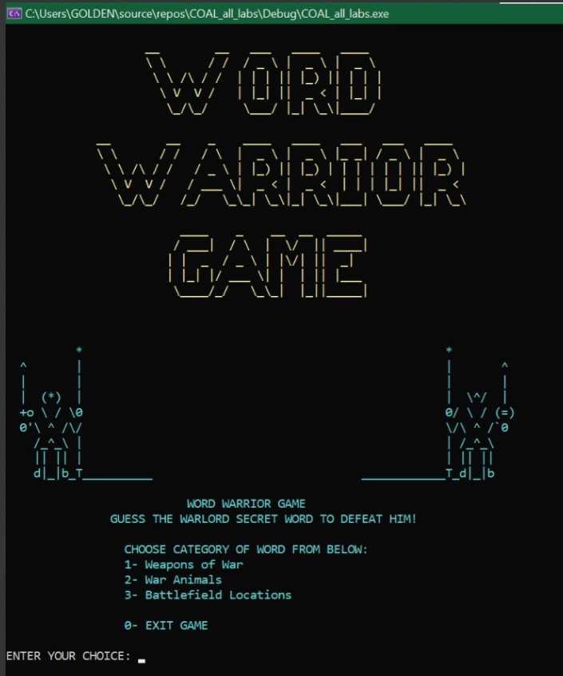
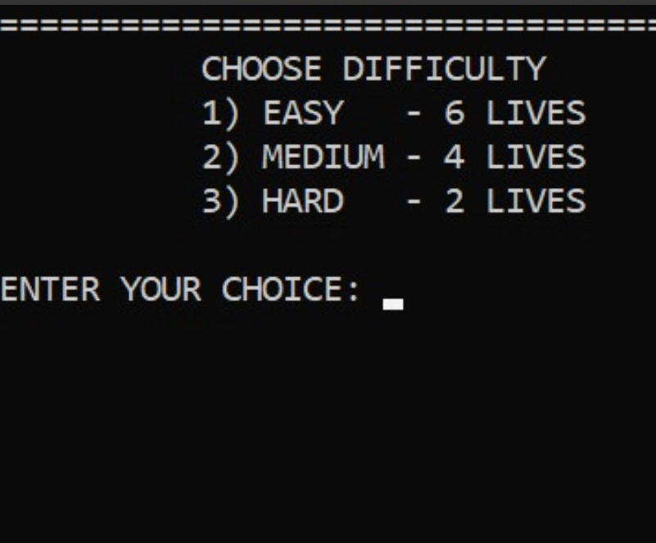
Gameplay Screenshots

Slide 11
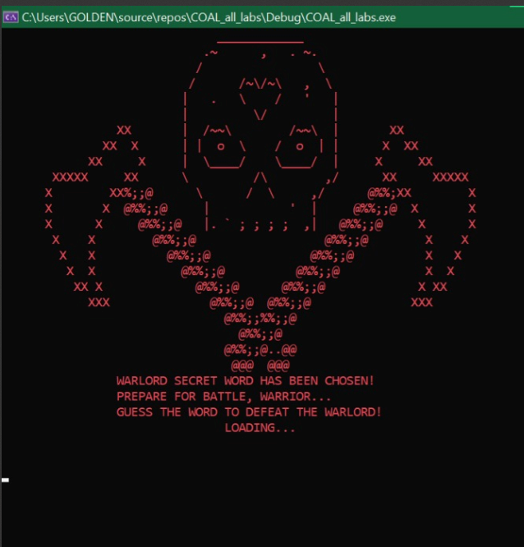
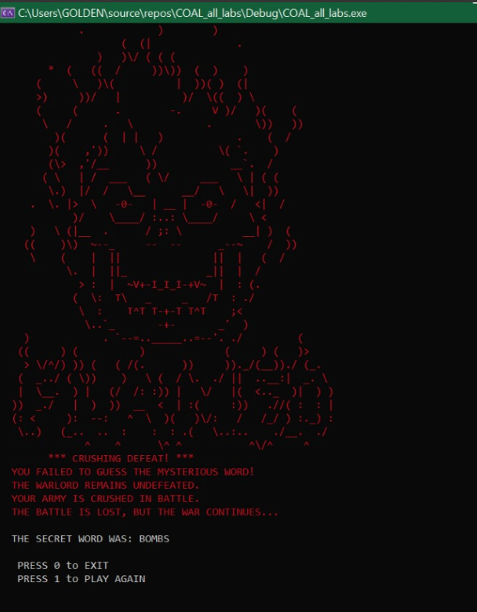
Gameplay Screenshots

Slide 12
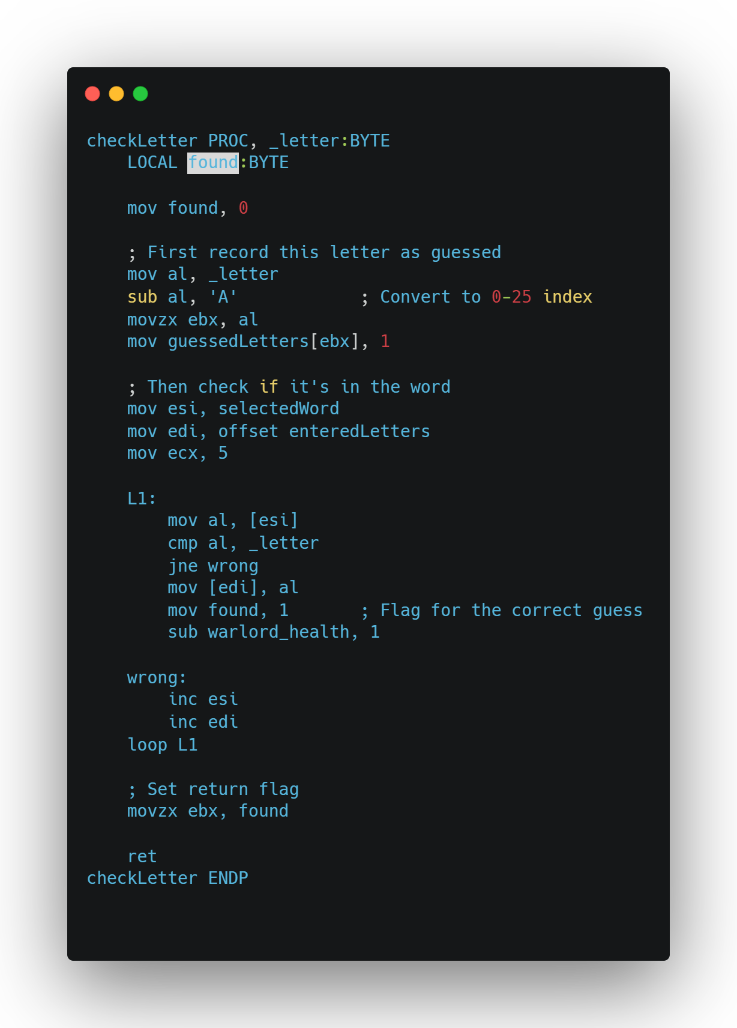
Check Letter Procedure
The check Letter procedure checks if the input letter exists in the selected word. It first marks the letter as guessed by updating the guessed Letters array. Then, it loops through each character in selected Word, comparing it with the guessed letter.

Slide 13
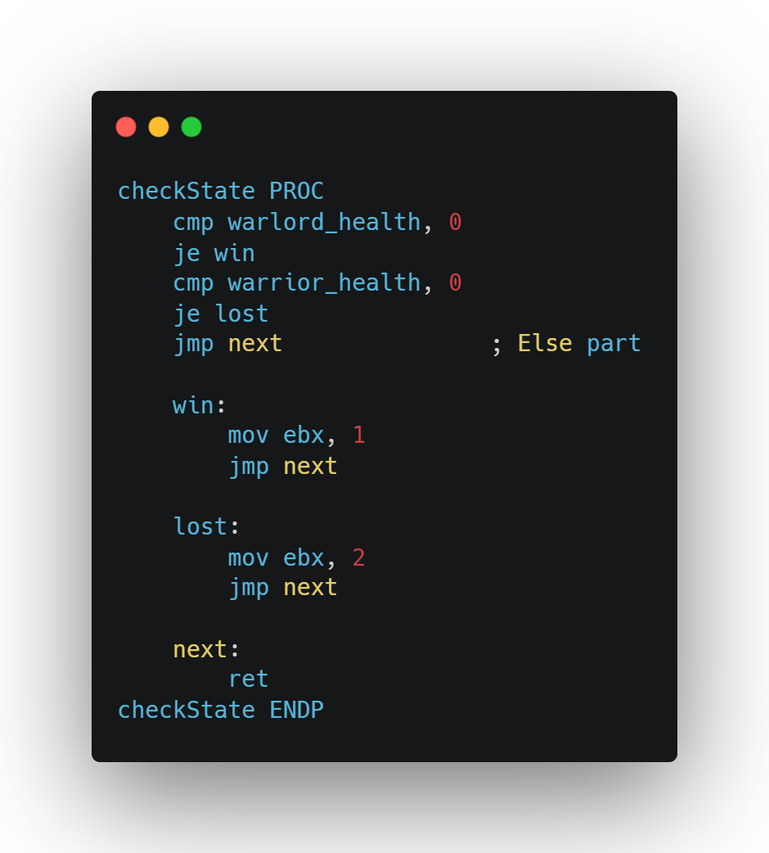
Check State PROC
The check State procedure evaluates the game status by checking the health values of the warlord and the warrior. If the warlord’s health reaches zero, it sets the return value in ebx to 1, indicating a win. If the warrior’s health is zero, it sets ebx to 2, indicating a loss. If neither condition is met, the procedure simply proceeds without changing ebx, allowing the game to continue.

Slide 14
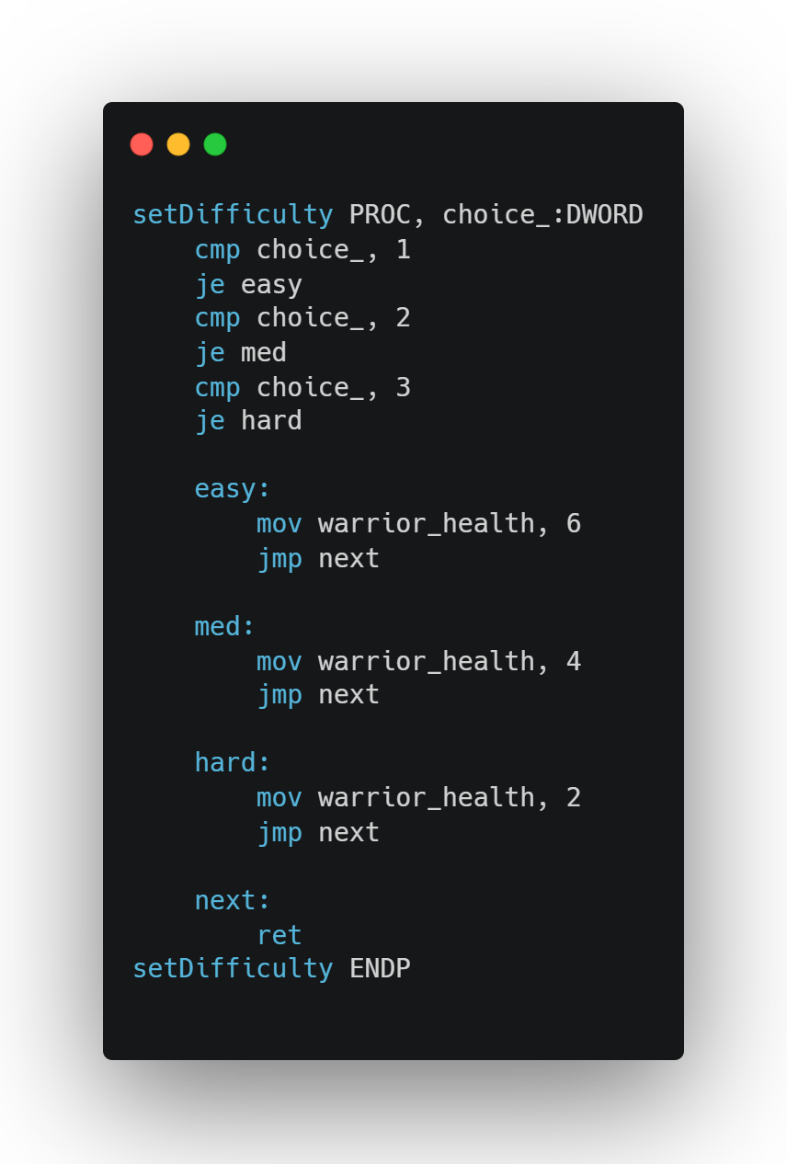
Set DIFFICULTY PROC
The set Difficulty procedure sets the initial health of the warrior based on the player's chosen difficulty level. It compares the input value choice_ with predefined options: 1 for easy, 2 for medium, and 3 for hard. Depending on the match, it assigns 6, 4, or 2 to warrior health respectively. After setting the appropriate value, the procedure returns to continue program execution.

Slide 15
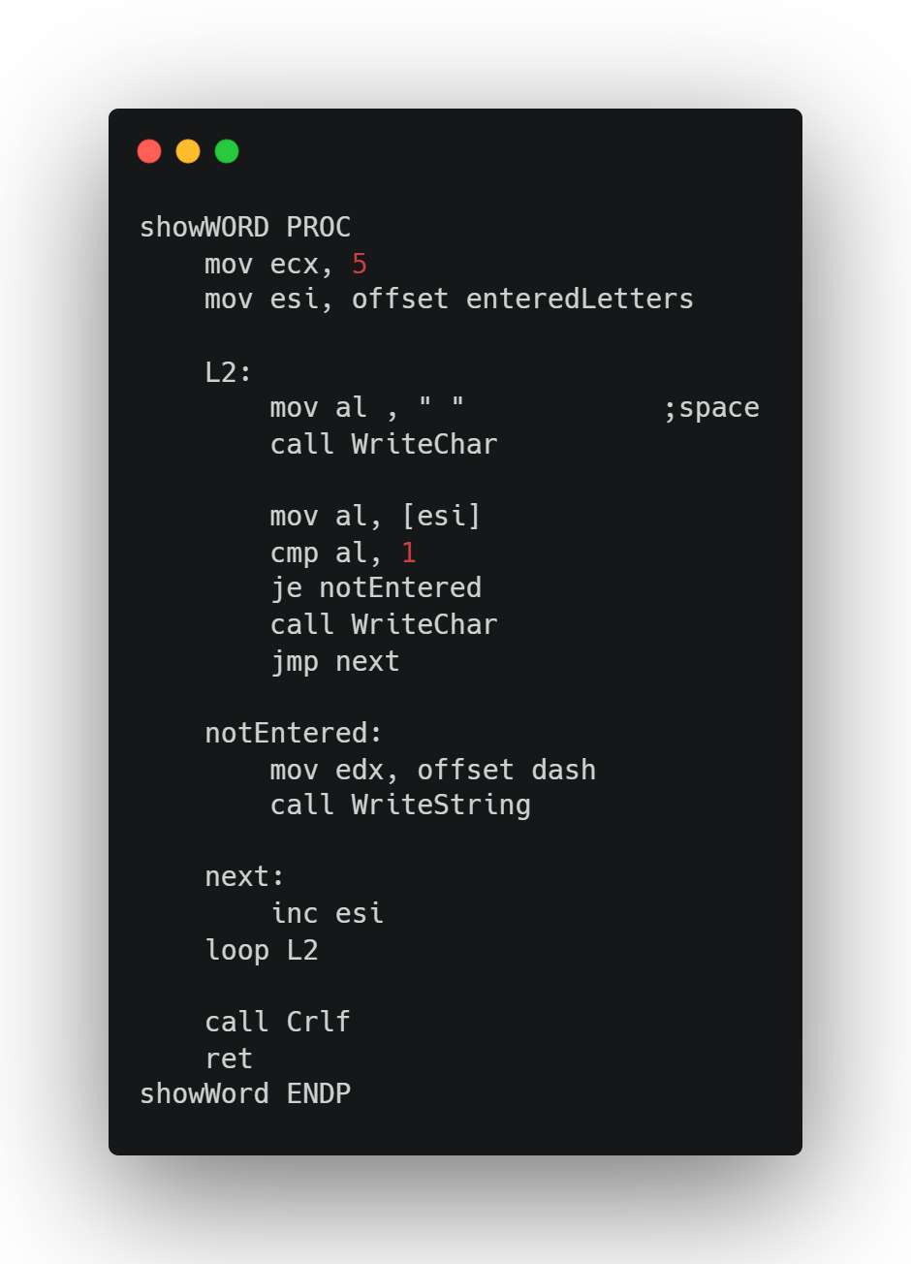
Check Letter Procedure
The check Letter procedure checks if the input letter exists in the selected word. It first marks the letter as guessed by updating the guessed Letters array. Then, it loops through each character in selected Word, comparing it with the guessed letter.

Slide 16
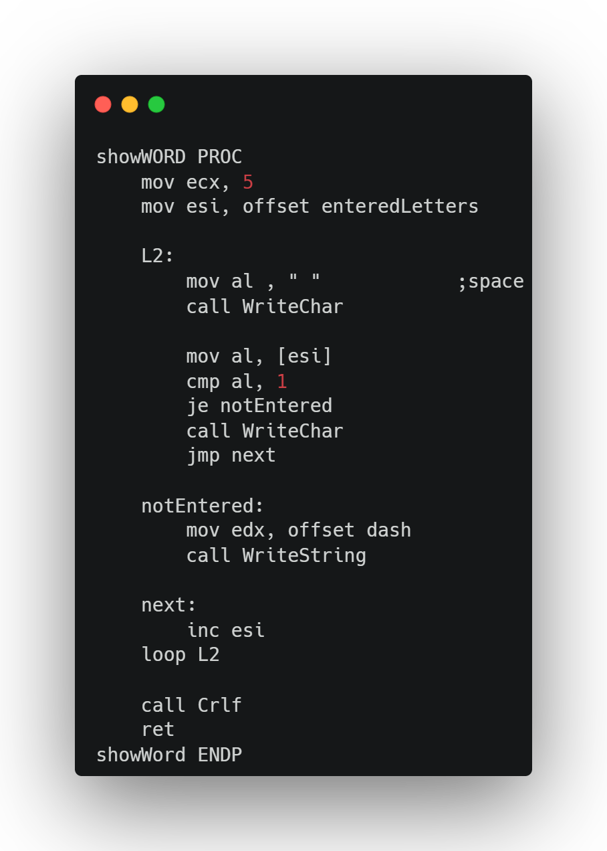
Display PROC
The procedure displays the current state of the guessed word. It loops through entered Letters, printing either the correct letter or a dash if the letter hasn't been guessed yet, with spaces in between. Finally, it moves to a new line.

Slide 17
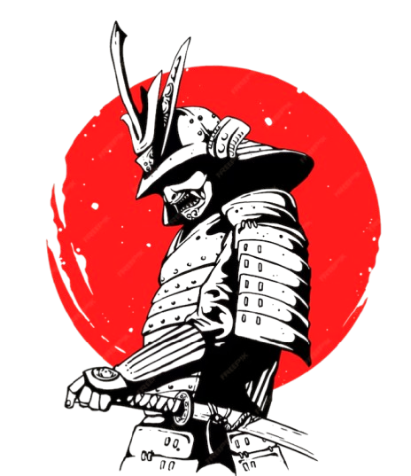
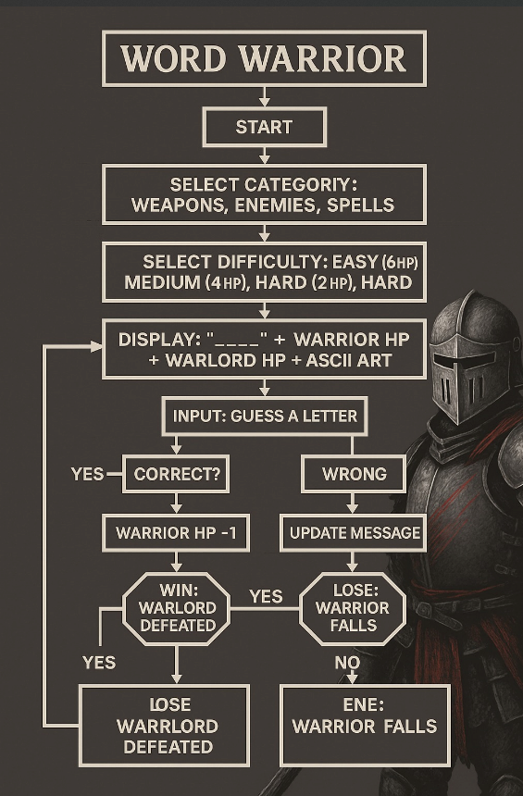
17

Slide 18
Use-cases:
Educational Tool: Demonstrates assembly concepts (loops, procedures, memory management)
Programming Challenge: Provides foundation for code extension competitions
Recreational Gaming: Offers text-based entertainment with battle narrative
Vocabulary Builder: Supports customizable word lists for language learning
Assembly Showcase: Illustrates creative possibilities within technical constraints

Slide 19
Conclusions:
Word Warrior' transforms Hangman into an epic battle, blending assembly programming with an engaging warrior vs. warlord theme.
Features like category selection, adjustable difficulty, and health/score tracking make it replay able and challenging.
ASCII art animations for the warlord add visual appeal.

Slide 20
Sufwan Masood
Hamna Nasir
Muhammad Abdul Rehman Wahla
Mahnoor
20

